Slide 1
MIDTRANS PILLOW FUNCTIONAL TESTING
Yulia Handayani

Slide 2
What to Test?
An e-Commerce Web Application of Midtrans Pillow.
What Feature to Test?
Test Homepage Feature
Test Register Feature
Test Payment Feature:
‘Checkout’ Form, ‘Order & Customer Details’, ‘Select Method’ Details, Payment Details

Slide 3
Functional Requirement
User can access https://demo.midtrans.com/ properly
User can successfully register
User can successfully checkout product
User can successfully make a payment

Slide 4
Tools
TOOLS NAME | SPECIFICATION | DESCRIPTION
Microsoft Excel | Microsoft 365 app | To make test case
Katalon | Version 8.2.5 | To make automation test case
Google Chrome | Version 100.0.4896.127 (Official Build) (64-bit) | To run automation script
Trello | Version web app | To report defect

Slide 5
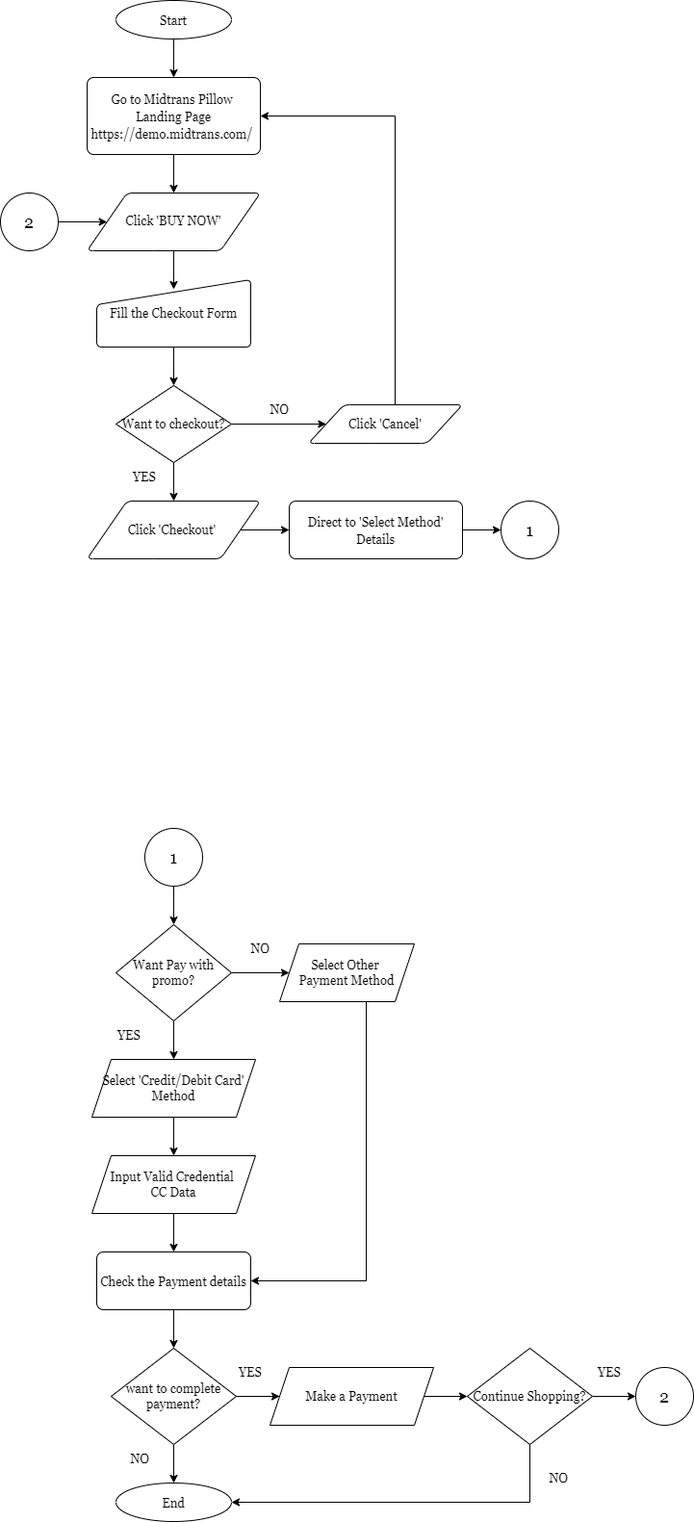

Payment FlowChart

Slide 6
Positive Test Case Summary
Test Case | Steps | Expected Result
User access Midtrans Pillow Web | Navigate to URL https://demo.midtrans.com/ | Homepage shown properly
User register a new account | Click Signup Input data | User will be redirected to https://dashboard.midtrans.com/register User succesfully registered
User input data on checkout form | Click Buy Now Input valid data on customer details fields | User can see shopping cart and customer detail on checkout form User successfully input data
User successfully checkout | Click ‘checkout’ button | User can see pay within time, order & customer details with data same as checkout input User can see payment methods with promo and without promo
User select payment method with promo | Select credit/debit card payment method | User can successfully pay with amount reduced
User select payment method without promo | Select other payment method | User can successfully pay with normal amount

Slide 7
Negative Test Case Summary
Test Case | Steps | Expected Result
User register without input data | Do not input data to all fields Click ‘register’ button | Show Error message field can't be blank to all fields
User checkout without input data | Do not input data on customer details fields Click ‘checkout’ button | User failed to checkout
User pay without input credential credit card data | User not input card number, expiry date and CVV field on ‘credit/debit card’ details | Shown warning on Card Number, Expiry Date and CVV Field
User pay using denied credit/debit card | Input denied credit card data Click ‘pay now’ Input password on issuing bank Click ‘ok’ button | Transaction Failed Error message "Your card got declined by the bank"
User pay without input account ID | Select payment method ‘Octo clicks’ Do not input account Id Click ‘bayar’ button | Show error message “Transaksi gagal”
User pay without input phone number | Select payment method ‘Akulaku’ Do not Input phone number Click ‘next’ button | Show message "Please Fill Out This Field"
User pay without input payment code | select payment method ‘Akulaku’ (with DP) Do not input payment code Click ‘Submit’ button | Show message "Please Fill Out This Field"

Slide 8
Automation Test Case Summary
Test Case | Steps | Status
User successfully checkout | Click ‘buy now’ button Input data on checkout form: - Verify shopping cart & customer detail Click ‘checkout’ button Redirect to ‘select method’ details: - Verify pay within time, order ID - Verify payment method list | Success running script
User successfully paid using ‘Credit/Debit card’ payment method with promo | Select ‘credit/debit card’ payment method Verify 6 radio buttons (5 promo not clickable & 1 no promo is clickable) Input credential credit/debit card data (Visa card) Verify 5 radio buttons are clickable & 1 radio button (mastercard) is not clickable Select promo Verify amount: - verify midtrans pillow price - verify total amount after select promo - verify customer details Click ‘Pay Now’ Directed to Issuing Bank: - verify amount - input password 5. Click ‘OK’ Button 6. Verify Transaction is successful | Success running script

Slide 9
Total Test Case
Test Suite | Total Test Case | Positive | Negative | Total Failed | Total Passed
[TS01] Homepage | 4 | 4 | 0 | 0 | 4
[TS02] Register | 40 | 13 | 27 | 0 | 40
[TS03] Payment | 90 | 51 | 39 | 12 | 78
Automation | 41 | 30 | 11 | 3 | 38

Slide 10
Failed Test Case Report
Click here, go to Trello

Slide 11
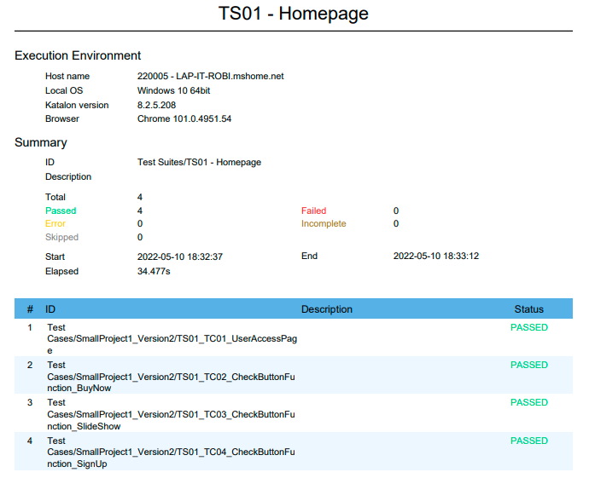
Report TS01 - Homepage

Slide 12
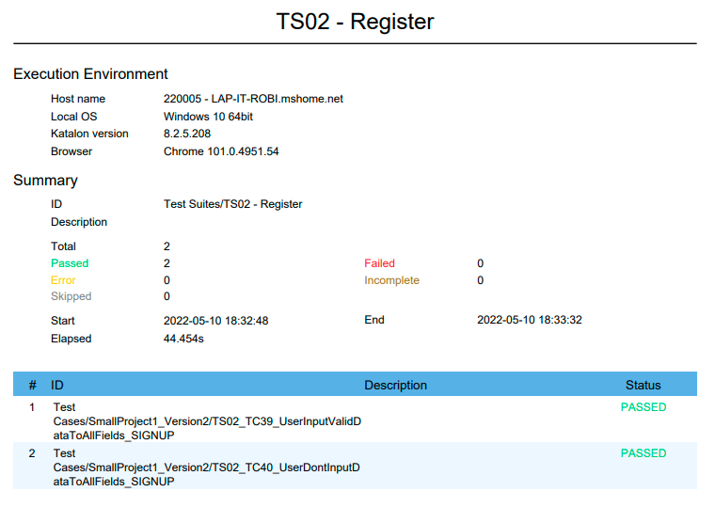
Report TS02 - Register

Slide 13
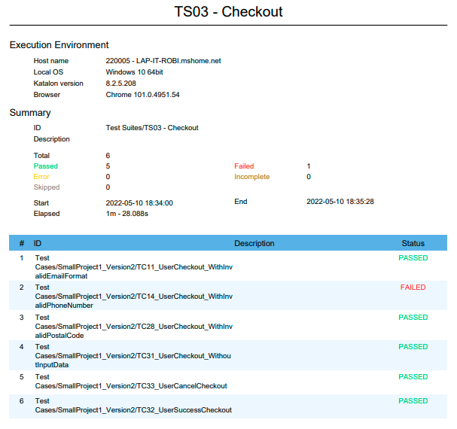
Report TS03 - Checkout

Slide 14
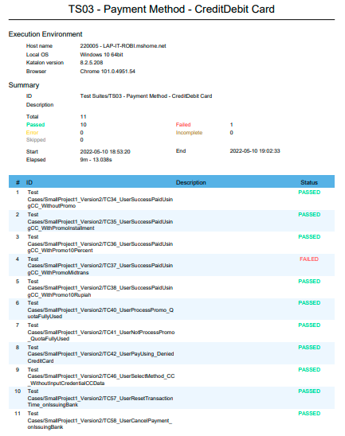
Report TS03 – Method – Credit/Debit

Slide 15
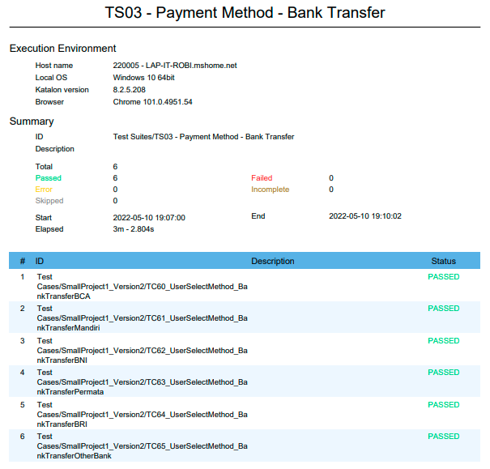
Report TS03 – Method - Bank Transfer

Slide 16
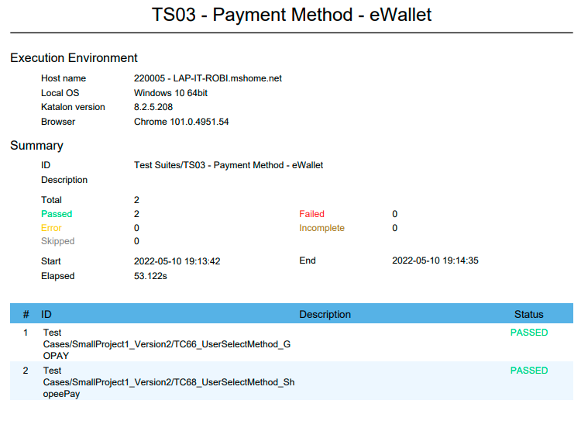
Report TS03 – Method – eWallet

Slide 17
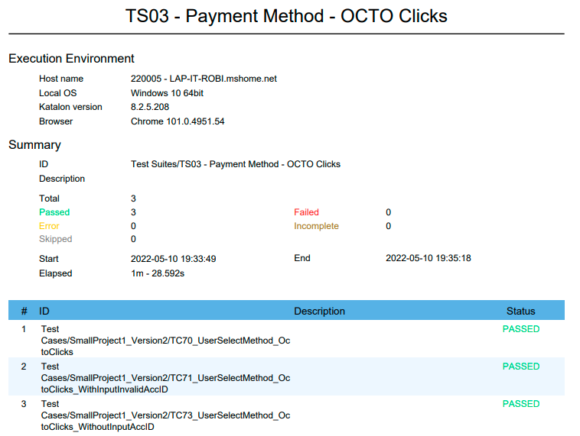
Report TS03 – Method – OCTO Clicks

Slide 18
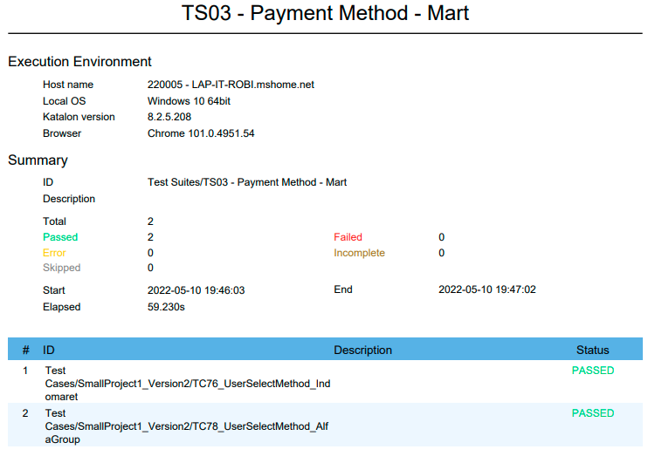
Report TS03 – Method – Mart

Slide 19
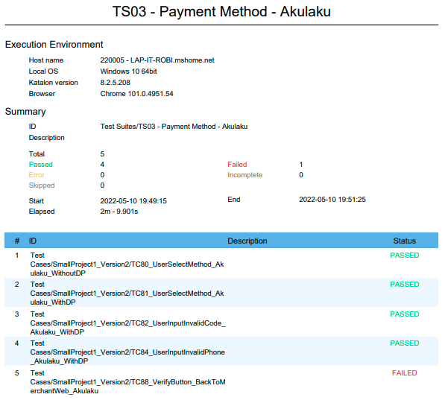
Report TS03 – Method - Akulaku

Slide 20
Thank You

